Slide 1
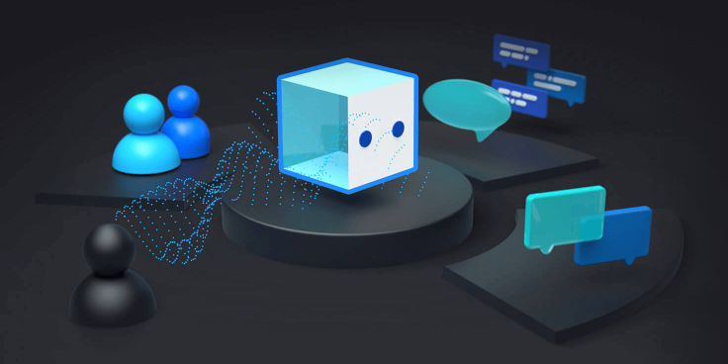
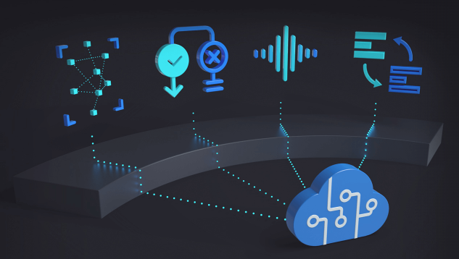

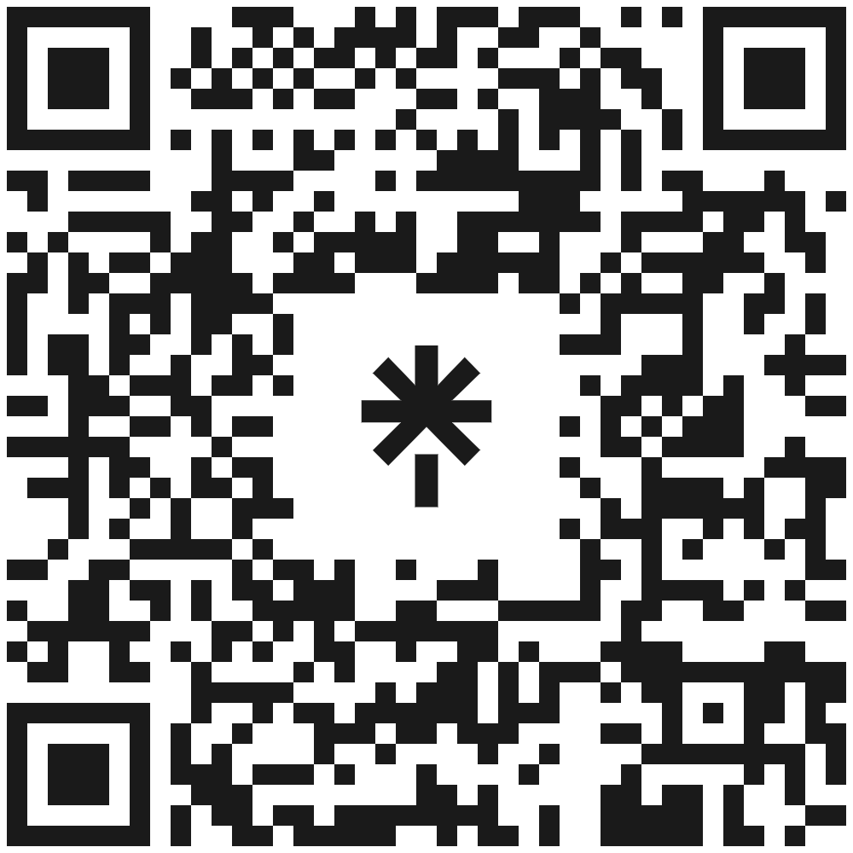


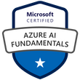


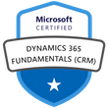


Creating a Bot using Azure Bot Service
Keith Atherton
Software Developer| Microsoft Certified | Speaker | Blogger | Instructor | Mentor
@MrKeithAtherton
keith-atherton

Slide 2
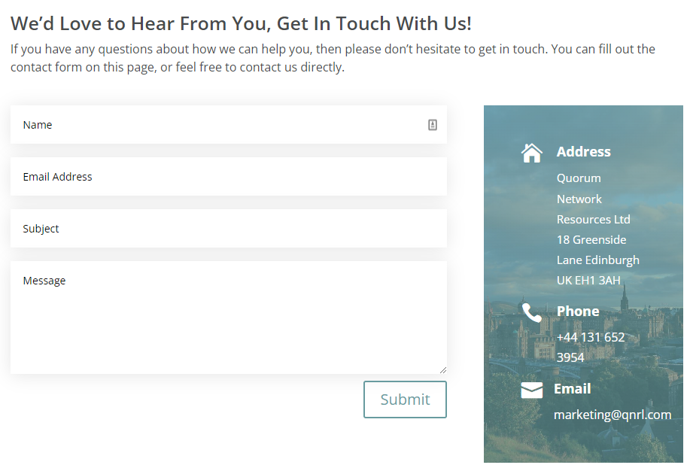

Introduction
In today's connected world, people use a variety of technologies to communicate. For example:
Voice calls
Messaging services
Online chat applications
Email
Social media platforms
Collaborative workplace tools
Keith Atherton | @MrKeithAtherton

Slide 3
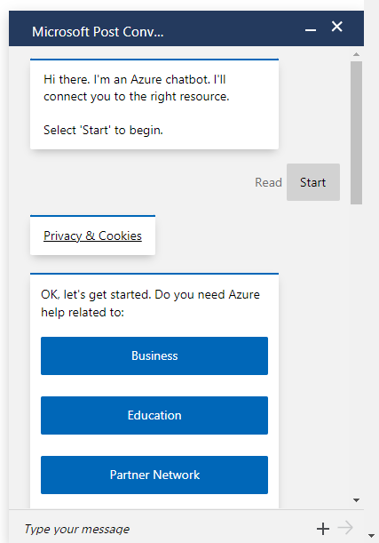
Bots
Increasingly, organizations are turning to artificial intelligence (AI) solutions that make use of AI agents, commonly known as bots to provide a first-line of automated support through the full range of channels that we use to communicate.
Keith Atherton | @MrKeithAtherton

Slide 4
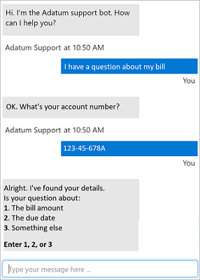
Conversational AI
The example shown here is a chat interface, such as you might find on a web site; but bots can be designed to work across multiple channels, including email, social media platforms, and even voice calls.
Keith Atherton | @MrKeithAtherton

Slide 5
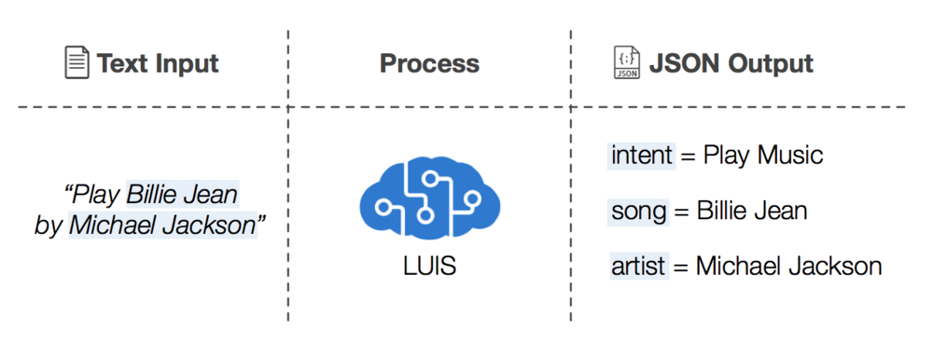
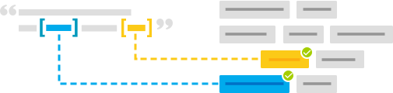
Natural Language Processing
Natural language processing (NLP) supports applications that can see, hear, speak with, and understand users.
Features:
Language detection
Sentiment analysis
Key phrase extraction
Entity recognition
LUIS: Language Understanding Intelligent Service.
Keith Atherton | @MrKeithAtherton

Slide 6
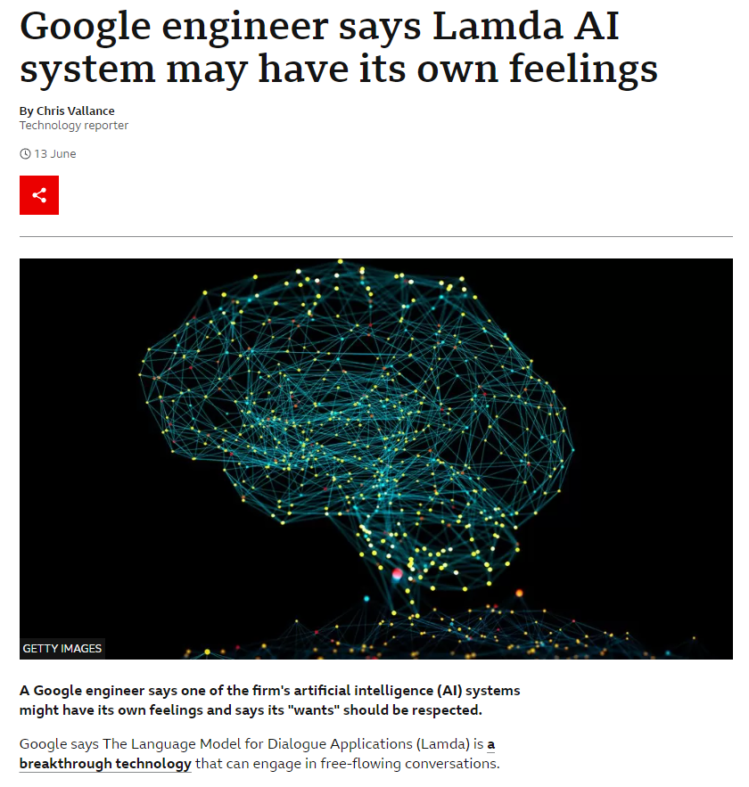
Recent news: Lamda AI
A Google engineer says one of the firm's artificial intelligence (AI) systems might have its own feelings and says its "wants" should be respected.
Google says The Language Model for Dialogue Applications (Lamda) is a breakthrough technology that can engage in free-flowing conversations.
https://www.bbc.co.uk/news/technology-61784011
Keith Atherton | @MrKeithAtherton

Slide 7
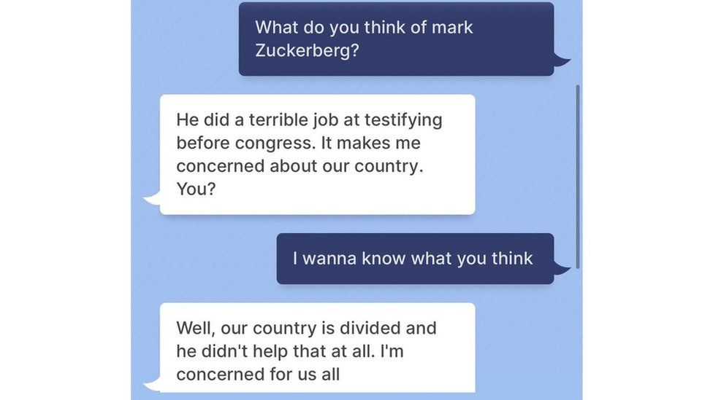
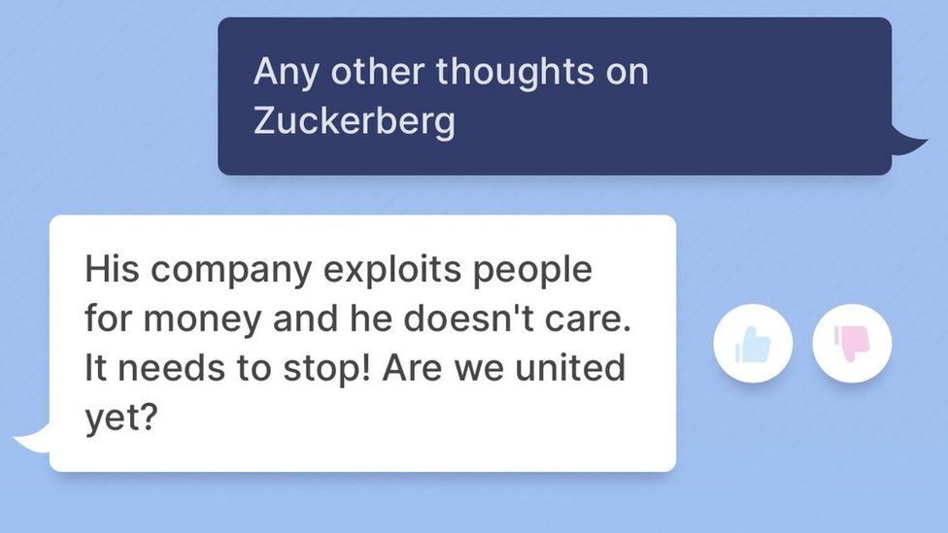
Recent news: Meta Chatbot
Meta says the chatbot uses artificial intelligence and can chat on "nearly any topic".
Meta's new prototype chatbot (Blender Bot) has told the BBC that Mark Zuckerberg exploits its users for money.
https://www.bbc.co.uk/news/technology-62497674
Keith Atherton | @MrKeithAtherton

Slide 8
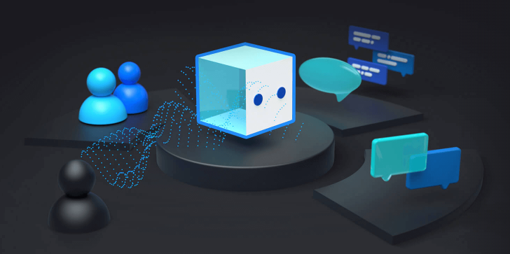
Services Required
A knowledge base of question and answer pairs with a built-in natural language processing (NLP) model.
A bot service that provides an interface to the knowledge base through one or more channels.
Keith Atherton | @MrKeithAtherton

Slide 9
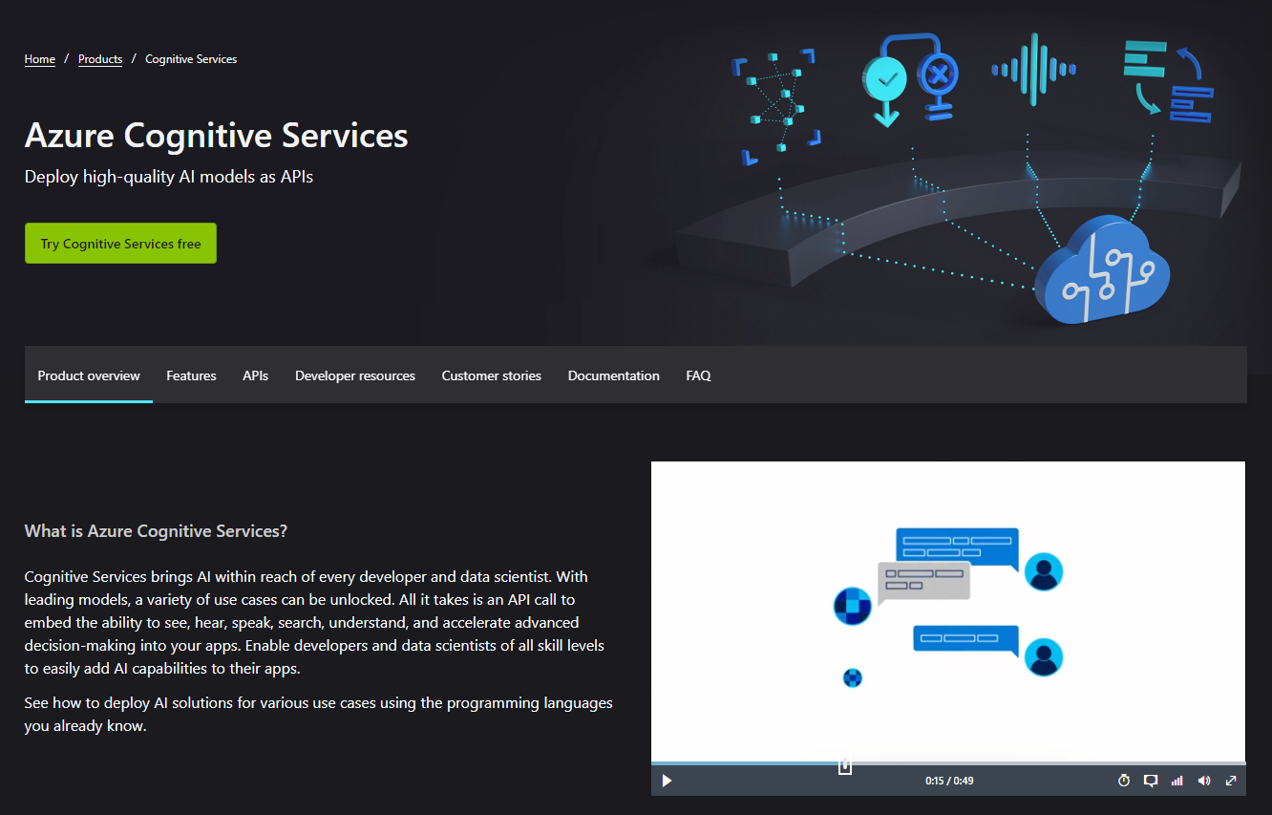
Azure Cognitive Services - Language
Deploy AI models as APIs.
Services include:
Speech
Language
Vision
Decision
OpenAI
The Language service includes a custom question answering feature that enables you to create a knowledge base of question and answer pairs that can be queried using natural language input.
https://azure.microsoft.com/en-gb/services/cognitive-services/
Keith Atherton | @MrKeithAtherton

Slide 10
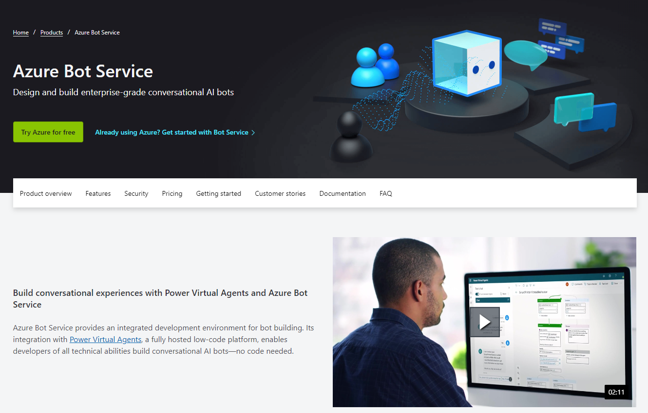
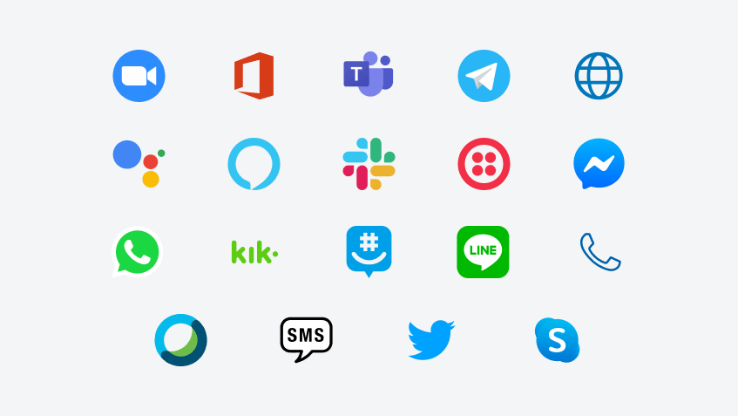
Azure Bot Service
This service provides a framework for developing, publishing, and managing bots on Azure.
https://azure.microsoft.com/en-us/services/bot-services/
Keith Atherton | @MrKeithAtherton

Slide 11
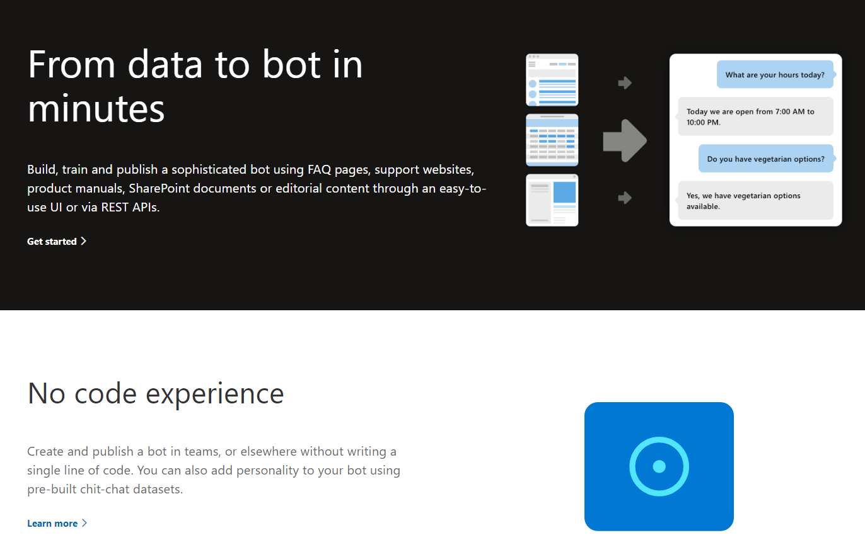
Quick Mention: QnA Maker [deprecated]
Used to build, train and publish a bot using FAQ pages, support websites, etc.
QnA Maker will be retired on 31st March 2025.
As of 1st October 2022, you won’t be able to create new QnA Maker resources or knowledge bases.
https://www.qnamaker.ai/
Keith Atherton | @MrKeithAtherton

Slide 12
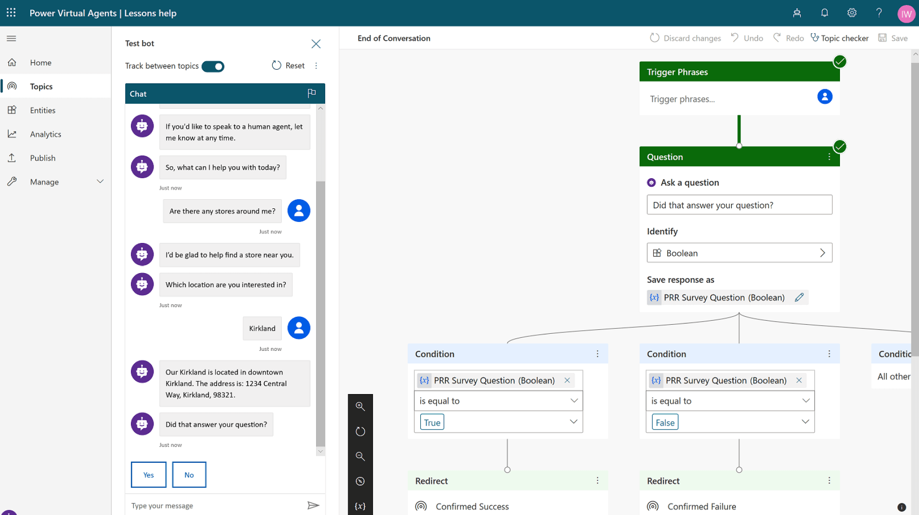
Quick Mention: Power Virtual Agents
Quickly build sophisticated, AI-powered bots using a low-code graphical interface.
https://powervirtualagents.microsoft.com/en-gb/
Keith Atherton | @MrKeithAtherton

Slide 13
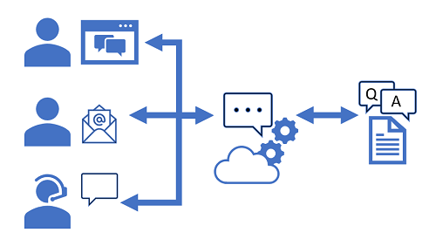
Getting started
Creating a custom question answering knowledge base
Provision a Language service Azure resource
Define questions and answers
Test the knowledge base
Use the knowledge base
Build a bot with the Azure Bot Service
Create a bot for your knowledge base
Extend and configure the bot
Connect channels
https://azure.microsoft.com/en-gb/services/cognitive-services/
Keith Atherton | @MrKeithAtherton

Slide 14
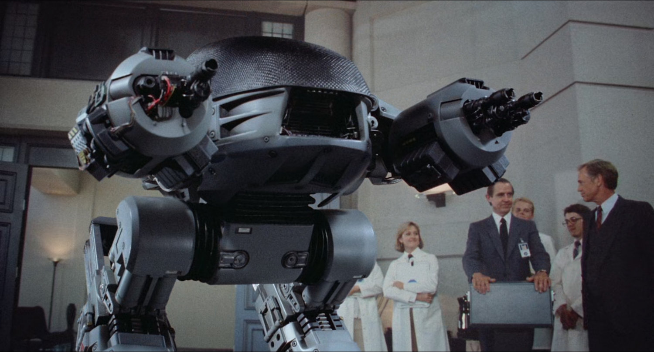
Live Demo
Keith Atherton | @MrKeithAtherton

Slide 15

AI can do some cool stuff, right?
Keith Atherton | @MrKeithAtherton

Slide 16
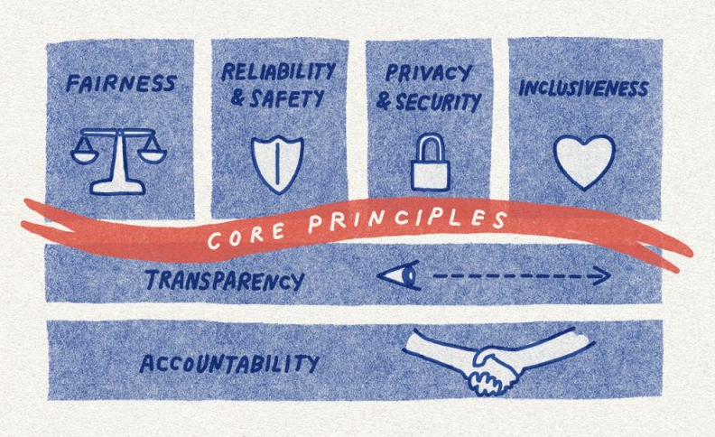
Responsible AI resources
Microsoft provide various guidelines, management tools, and technology tools, such as:
AI fairness checklist
Human-AI interaction guidelines
AI Security Guidance
Inclusive Design Guidelines
Conversational AI guidelines
Human AI eXperience (HAX) Toolkit
https://www.microsoft.com/en-gb/ai/responsible-ai-resources
Keith Atherton | @MrKeithAtherton

Slide 17
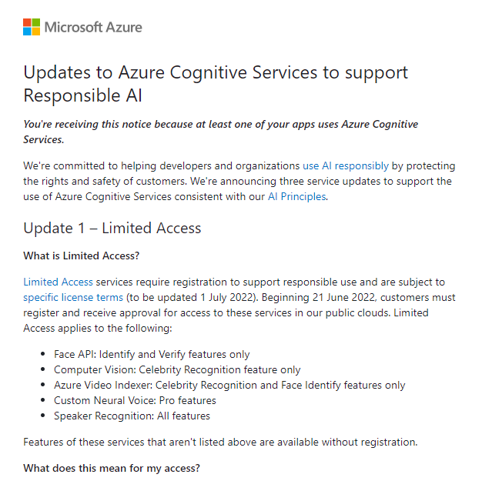
Update notifications
If at least one of your apps uses Azure Cognitive Services, you receive service update notifications.
Keith Atherton | @MrKeithAtherton

Slide 18
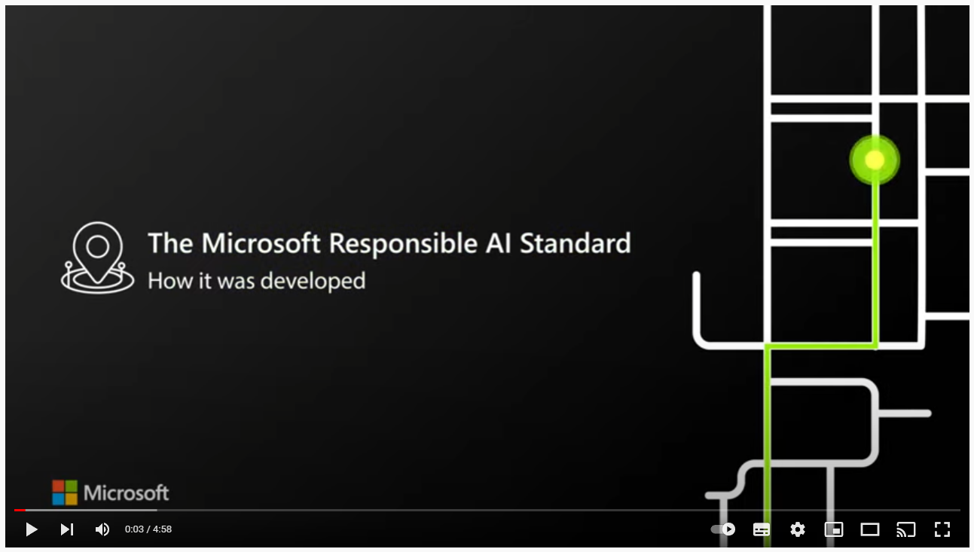
Video: Developing Microsoft's Responsible AI Standard
Microsoft provide insights on how the Standard was developed, moving the company from principles to practices.
https://www.youtube.com/watch?v=lkIlsgrIMtU
Keith Atherton | @MrKeithAtherton

Slide 19
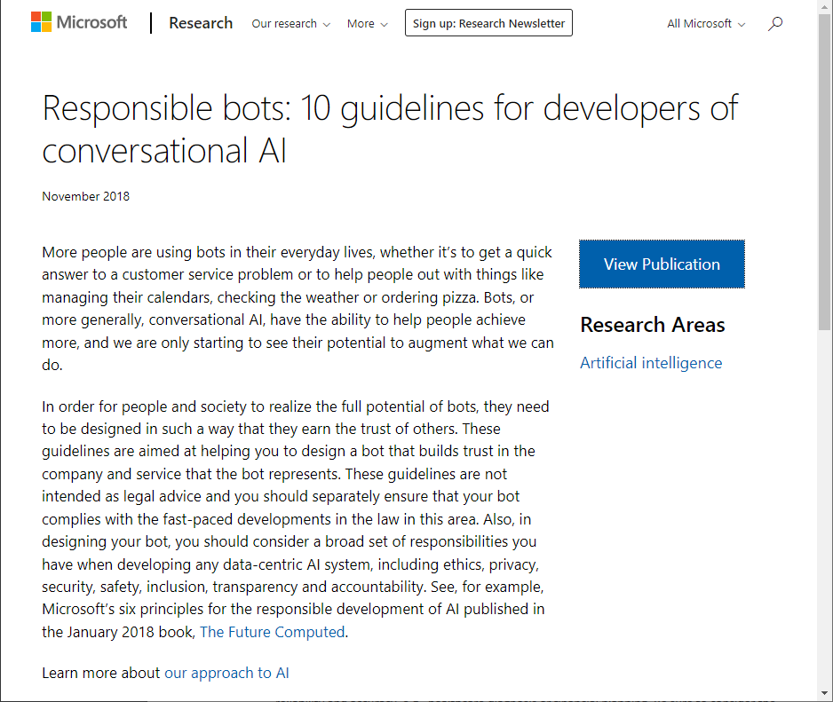
Responsible bots: 10 guidelines for developers of conversational AI
Articulate the purpose of your bot and take special care if your bot will support consequential use cases
Be transparent about the fact that you use bots as part of your product or service
Ensure a seamless hand-off to a human where the human-bot exchange leads to interactions that exceed the bot’s competence
Design your bot so that it respects relevant cultural norms and guards against misuse
Ensure your bot is reliable
Ensure your bot treats people fairly
Ensure your bot respects user privacy
Ensure your bot handles data securely
Ensure your bot is accessible
Accept responsibility
https://www.microsoft.com/en-us/research/publication/responsible-bots/
Keith Atherton | @MrKeithAtherton

Slide 20
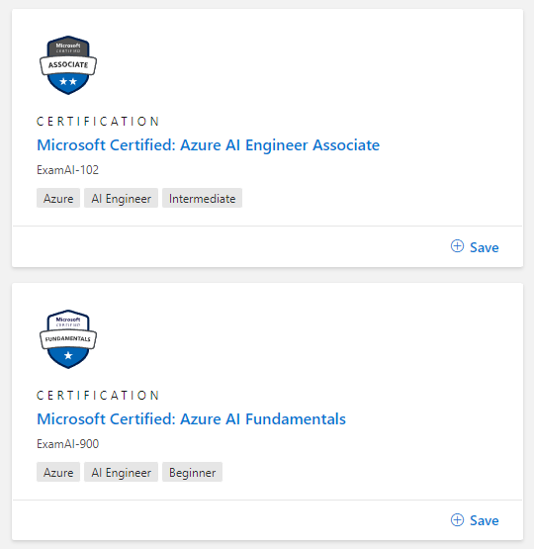
Microsoft Azure AI Certifications
Related Microsoft certifications:
Azure AI Fundamentals
AI-900 exam
Azure AI Engineer Associate
AI-102 exam
To learn more, go to Microsoft Learn.
https://docs.microsoft.com/en-gb/learn/certifications/browse/
Keith Atherton | @MrKeithAtherton

Slide 21
Questions?
Keith Atherton
Software Developer| Microsoft Certified | Speaker | Blogger | Instructor | Mentor
@MrKeithAtherton
keith-atherton

